Slide 1
Software Requirements Engineering
Engr. Sara Rehmat

Slide 2
Establishing business requirements
Business Requirements and why we need to establish them
Product Vision and Project Scope
Vision and Scope Document

Slide 3
Defining business requirements
Business requirements specify why the product is being developed.
They define product vision and project scope of the product.
The business requirements represent the top of the requirements chain.
The user requirements and functional requirements must align with the business requirements .
Requirements that don’t help the project achieve its business objectives shouldn’t be implemented.
The business requirements are recorded in the vision and scope document.

Slide 4
Benefits of identifying business requirements
Business requirements establish the business objectives.
Without reaching a common understanding of the business objectives by all stakeholders,
We will have more conflicting requirements among the stakeholders
The project will lack direction and may run into overrun budgets and missed deadlines.

Slide 5
Product Vision and Project Scope
Product Vision
The product vision succinctly describes the ultimate product that will achieve the business objectives.
The vision describes what the product is about and what it ultimately could become.
The product vision aligns all stakeholders in a common direction.
The vision applies to the product as a whole.

Slide 6
Product Vision and Project Scope
Project Scope
The project scope identifies what portion of the ultimate product vision the current project or development iteration will address.
The statement of scope draws the boundary between what’s in and what’s out for this project.
Scope is more dynamic than vision because the stakeholders adjust the contents of each release within its schedule, budget, resource, and quality constraints.
Scope for the current release should be clear, but the scope of future releases will be fuzzier the farther out you look.

Slide 7
Conflicting Business Requirements
Business requirements collected from multiple sources might conflict.

Slide 8
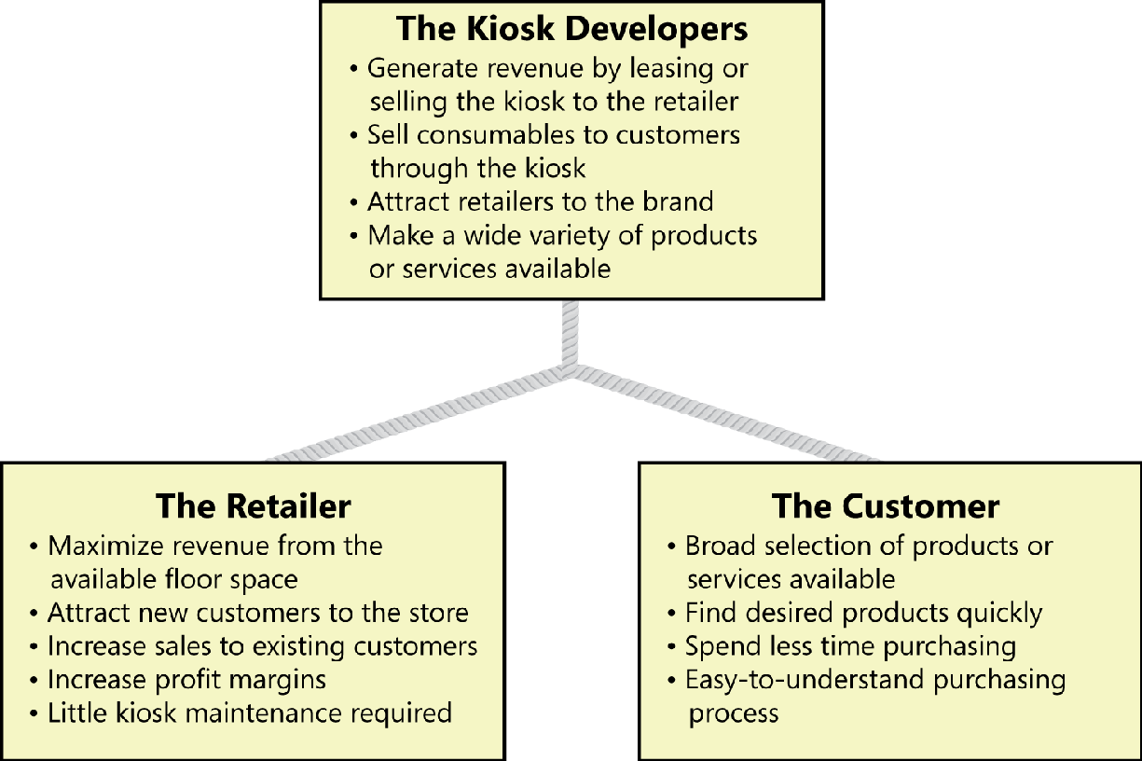
Stakeholders for a kiosk don’t always have congruent business interests.

Slide 9
The various stakeholders’ objectives sometimes are in alignment.
For instance, both the kiosk developers and the customers want to have a wide variety of products or services available through the kiosk.
However, some business objectives could conflict.
The customer wants to spend less time purchasing goods and services, but the retailer would prefer to have customers linger in the store and buy more items.
The project’s decision makers must resolve these conflicts before the analyst can detail the kiosk’s requirements.

Slide 10
Vision and scope document
The vision and scope document collects the business requirements into a single deliverable that sets the stage for the subsequent development work.
Similar documents: a project charter or a business case document.
Organizations that build commercial software often create a market (or marketing) requirements document (MRD).

Slide 11
Vision and Scope document
The vision and scope document only defines the scope at a high level; the scope details are represented by each release baseline that the team defines
Major new projects should have both a complete vision and scope document and an SRS.

Slide 12
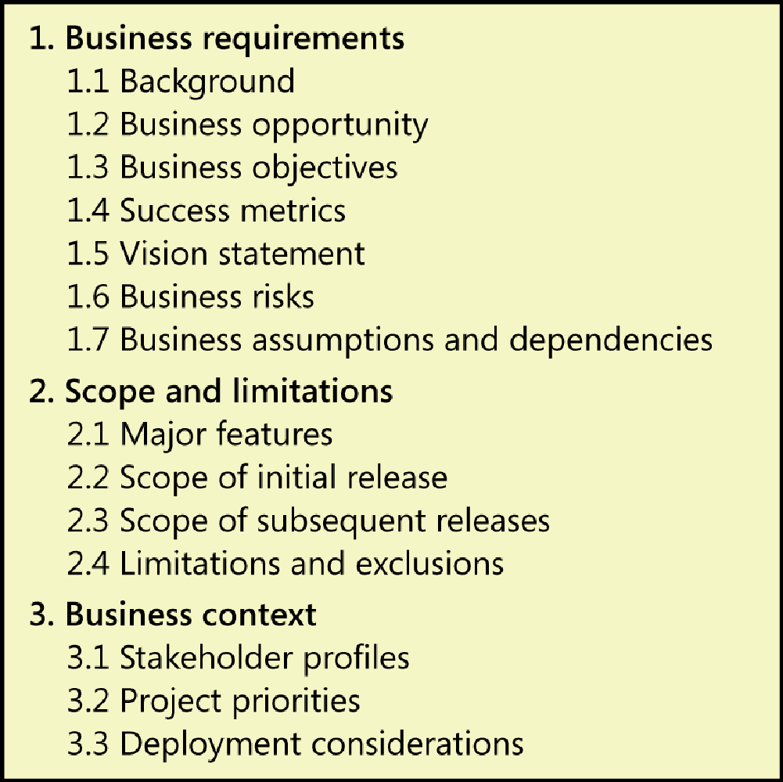
Template of Vision and Scope document

Slide 13
1. Business requirements
1.1 Background
Summarize the rationale and context for the new product or for changes to be made to an existing one.
1.2 Business Opportunity
For a corporate information system, describe the business problem that is being solved or the process being improved, as well as the environment in which the system will be used.
For a commercial product, describe the business opportunity that exists and the market in which the product will be competing.
Include a comparative evaluation of existing products, indicating why the proposed product is attractive and the advantages it provides.

Slide 14
1. Business requirements
1.2 Business Opportunity
Describe the problems that cannot currently be solved without the envisioned solution.
List any other technologies, processes, or resources required to provide a complete customer solution.
Describe the needs of typical customers or of the target market.
Present customer problems that the new product will address.
Provide examples of how customers would use the product.

Slide 15
1. Business Requirements 1.3 Business Objectives
Summarize the important business benefits the product will provide in a quantitative and measurable way.
Platitudes (“become recognized as a world-class <whatever>”) and vaguely stated improvements (“provide a more rewarding customer experience”) are neither helpful nor verifiable.

Slide 16
Examples of financial business objectives
Capture a market share of X% within Y months.
Increase market share in country W from X% to Y% within Z months.
Reach a sales volume of X units or revenue of $Y within Z months.
Achieve X% return on investment within Y months.
Achieve positive cash flow on this product within Y months.
Save $X per year currently spent on a high-maintenance legacy system.
Reduce monthly support costs from $X to $Y within Z months.
Increase gross margin on existing business from X% to Y% within 1 year.

Slide 17
Examples of non-financial business objectives
Achieve a customer satisfaction measure of at least X within Y months of release.
Increase transaction-processing productivity by X% and reduce data error rate to no more than Y%.
Develop an extensible platform for a family of related products.
Develop specific core technology competencies.
Be rated as the top product for reliability in published product reviews by a specified date.
Comply with specific federal and state regulations.
Receive no more than X service calls per unit and Y warranty calls per unit within Z months after shipping.
Reduce turnaround time to X hours on Y% of support calls.

Slide 18
Case study
Gerhard, a senior manager at Contoso Pharmaceuticals, was meeting with Cynthia, the manager of Contoso’s IT department. “We need to build a chemical tracking information system,” Gerhard began. “The system should keep track of all the chemical containers we already have in the stockroom and in laboratories. That way, the chemists can get some chemicals from someone down the hall instead of always buying a new container. This should save us a lot of money. Also, the Health and Safety Department needs to generate government reports on chemical usage and disposal with a lot less work than it takes them today. Can you build this system in time for the compliance audit in five months?”

Slide 19
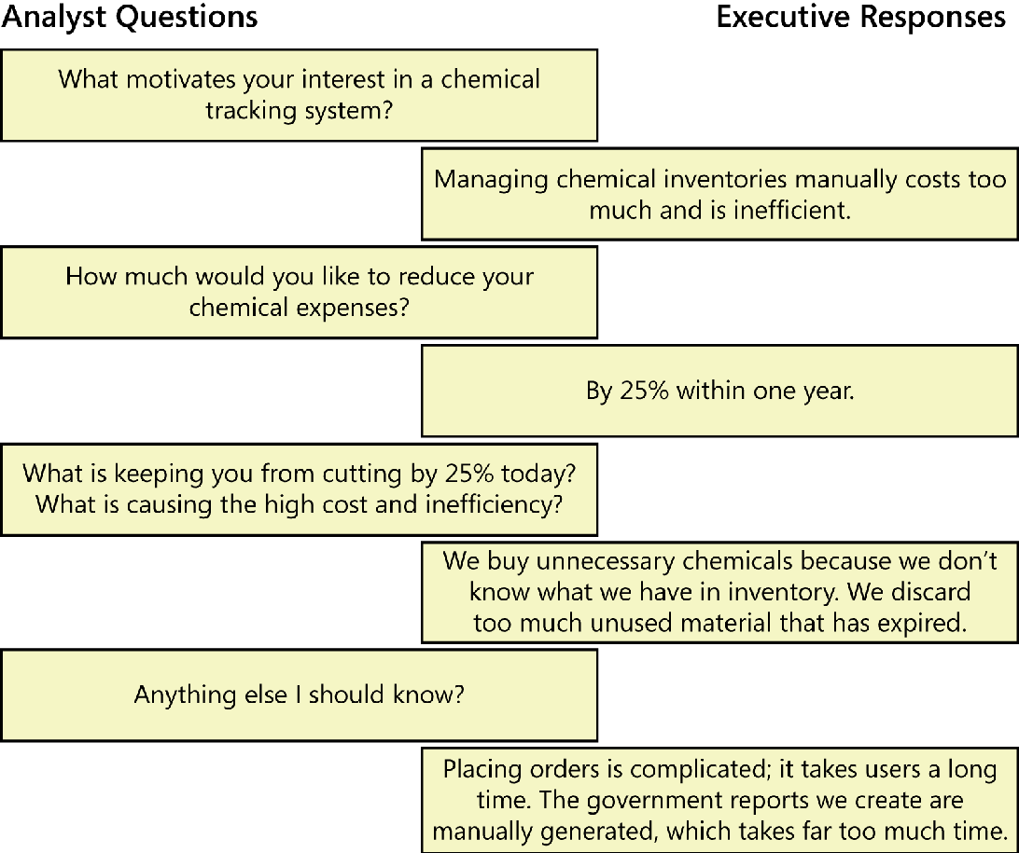
Example of a conversation between a business analyst and an executive sponsor.

Slide 20
Hierarchy of business problems and objectives
Each business has certain goals.
The problems describe what is keeping the business from meeting their goals at present, whereas the objectives define ways to measure achievement of those goals.
A business objectives model shows a hierarchy of related business problems and measurable business objectives

Slide 21
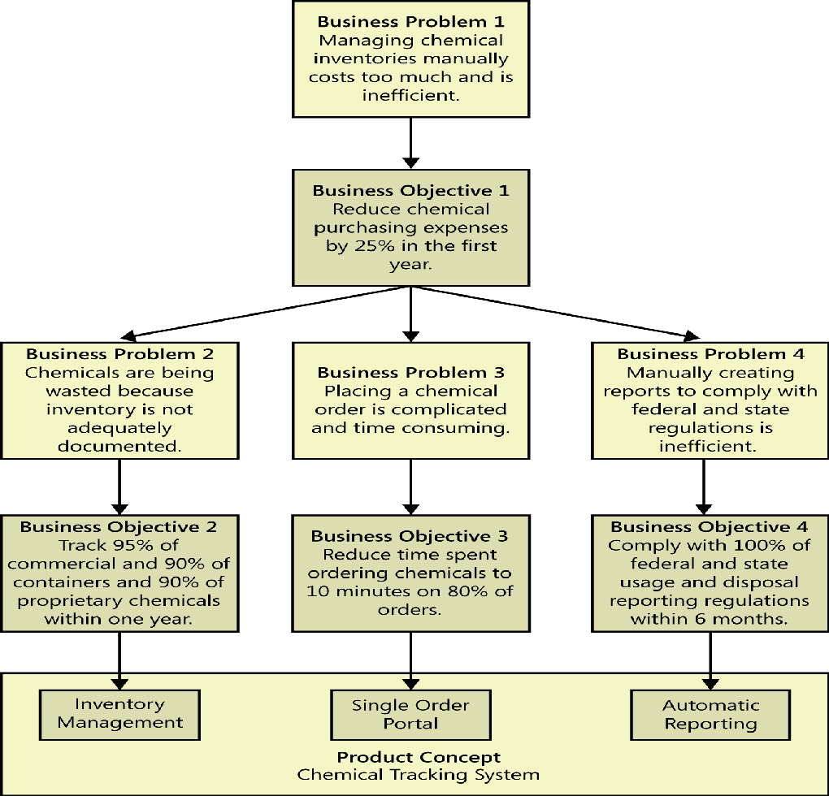
Example business objectives model for the Chemical Tracking System.

Slide 22
Given a set of business objectives, ask, “What is keeping us from achieving the goal?” to identify a more detailed business problem. Or work backward by asking, “Why do we care about that goal?” to better understand the top-level business problem or opportunity. Given a business problem, ask, “How will we assess whether the problem is solved?” to identify the measurable objective. The process is iterative, cycling through the hierarchy of problems and objectives until you see a list of features emerge that would help solve the problems and meet the objectives.

Slide 23
1.4 Success Metrics
Specify the indicators that stakeholders will use to define and measure success on this project.
Business objectives sometimes cannot be measured until well after a project is complete.
Achieving the business objectives might be dependent on projects beyond your current one.
However, it’s still important to evaluate the success of an individual project.
Success metrics indicate whether a project is on track to meet its business objectives.

Slide 24
1.5 Vision Statement
Write a concise vision statement that summarizes the long-term purpose and intent of the product.
It can be somewhat idealistic but should be grounded in the realities of existing or anticipated markets, enterprise architectures, corporate strategic directions, and resource limitations.
For [target customer]
Who [statement of the need or opportunity]
The [product name]
Is [product category]
That [major capabilities, key benefit, compelling reason to buy or use]
Unlike [primary competitive alternative, current system, current business process]
Our product [statement of primary differentiation and advantages of new product]

Slide 25
1.5 Vision Statement - Example
For scientists who need to request containers of chemicals, the Chemical Tracking System is an information system that will provide a single point of access to the chemical stockroom and to vendors. The system will store the location of every chemical container within the company, the quantity of material remaining in it, and the complete history of each container’s locations and usage. This system will save the company 25 percent on chemical costs in the first year of use by allowing the company to fully exploit chemicals that are already available within the company, dispose of fewer partially used or expired containers, and use a standard chemical purchasing process. Unlike the current manual ordering processes, our product will generate all reports required to comply with federal and state government regulations that require the reporting of chemical usage, storage and disposal.

Slide 26
1.6 Business risks
Summarize the major business risks associated with developing—or not developing—this product. Risk categories include marketplace competition, timing issues, user acceptance, implementation issues, and possible negative impacts on the business.
Business risks are not the same as project risks, which often include resource availability concerns and technology factors.

Slide 27
1.7 Business assumptions and dependencies
An assumption is a statement that is believed to be true in the absence of proof or definitive knowledge.
Business assumptions are specifically related to the business requirements.
If you learn that certain assumptions are wrong, you might have to change scope, adjust the schedule, or launch other projects to achieve the objectives.
Record any assumptions that the stakeholders made when conceiving the project and writing their vision and scope document. Often, one party’s assumptions are not shared by others. If you write them down and review them, you can avoid possible confusion and aggravation in the future.

Slide 28
1.7 Business assumptions and dependencies
Record any major dependencies the project has on external factors. Examples are pending industry standards or government regulations, deliverables from other projects, third-party suppliers, or development partners.
Broken dependencies are common source of project delays.

Slide 29
2. Scope and limitations
A software project should define its scope and limitations. You need to state both what the solution being developed is (scope) and what it is not (limtitations).
The first step to controlling scope creep is to define the project’s scope.
At the highest level, scope is defined when the customer decides which business objectives to target.
At a lower level, scope is defined at the level of features, user stories, use cases, or events and responses to include.
Scope ultimately is defined through the set of functional requirements planned for implementation in a specific release or iteration.
At each level, the scope must stay within the bounds of the level above it. For example, in-scope user requirements must map to the business objectives, and functional requirements must map to user requirements that are in scope.

Slide 30
2.1 Major Features
List the product’s major features or user capabilities, emphasizing those that distinguish it from previous or competing products.
Think about how users will use the features, to ensure that the list is complete and that it does not include unnecessary features that sound interesting but don’t provide customer value.
Give each feature a unique and persistent label to permit tracing it to other system elements. You might include a feature tree diagram.

Slide 31
2.2 Scope of the initial release
Summarize the capabilities that are planned for inclusion in the initial product release.
Often defined in terms of features,user stories, use cases, use case flows, or external events.
Describe the quality characteristics
Avoid the temptation to include every feature that any ­potential customer might eventually want in release 1.0.
Bloatware and slipped schedules are common outcomes of such insidious scope stuffing.
Focus on those features that will provide the most value, at the most acceptable cost, to the broadest community, in the earliest time frame.

Slide 32
2.3 Scope of the subsequent releases
If you are following an iterative or incremental life cycle, build a release roadmap that indicates which functionality chunks will be deferred and the desired timing of later releases.
The farther out you look, the fuzzier these future scope statements will be and the more they will change over time.
Short release cycles provide frequent opportunities for learning based on customer feedback.

Slide 33
2.4 Limitations or exclusions
List any product capabilities or characteristics that a stakeholder might expect but that are not planned for inclusion in the product or in a specific release.
List items that were cut from scope, so the scope decision is not forgotten.
Maybe a user requested that she be able to access the system from her phone while away from her desk, but this was deemed to be out of scope. State that explicitly in this section: “The new system will not provide mobile platform support.”

